Slide 1
Scientific Revolution Sparks the Enlightenment (1700-1800)
1500s and 1600s had transformed the way people in Europe looked at the world.
Scientific successes convinced educated Europeans of the power of human reason. (Copernicus, Galileo, & Newton)
Natural Law, or rules discoverable by reason, govern scientific forces such as gravity and magnetism.
Why not then, use natural law to better understand social, economic, and political problems?

Slide 2
As a Result
Using the methods of the new science, reformers thus set out to study human behavior and solve the problems of society.
In this way, the Scientific Revolution led to the Enlightenment because it made them question…

Slide 3
Questions
…if new ideas in Math and Science were true then:
Was it true that kings ruled with god’s authority?
Was it reasonable for the poor to pay higher taxes than the rich?
Was it always necessary for some to be rich and others poor?
Why was all the power in the king and no power in the people?

Slide 4
Thomas Hobbes & John Locke
17th century English thinkers
Both set forth ideas that were to become key to the Enlightenment.
Both lived through the upheavals of the English Civil War.
Yet, they came to very different conclusions about human nature and the role of government.

Slide 5
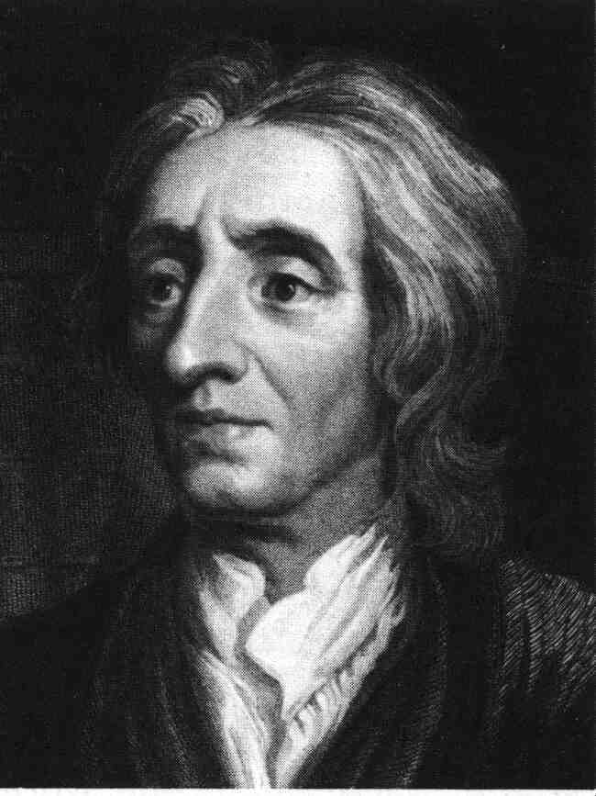
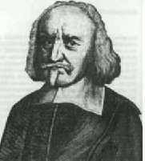
Thomas Hobbes vs. John Locke
AIM: What is the difference between Hobbes and Locke’s view of government?
Two Visions of
Government and Rights

Slide 6
Social Contract Theory
Imagine two situations:
Government (the state)
No government (the state of nature)
Which would you choose? Why?

Slide 7
Student Polls
Do you think people are: | Good | Bad
Should we have: | Government | State of Nature

Slide 8
Thomas Hobbes (1588-1679)
Wrote Leviathan – argued that people were “naturally cruel, greedy, and selfish.”
Life in the state of nature would be “solitary, poor, nasty, brutish and short.”
To escape that fate, people entered into a social contract – an agreement by which they gave up their freedom for an organized society.
Only a powerful government could ensure an orderly society.
Absolute Monarchy
Didn’t believe in Revolutions

Slide 9
Hobbes’s Social Contract
You would give up
Liberty
To gain
Security

Slide 10
John Locke
More optimistic than Hobbes – people were basically reasonable and moral.
Natural Rights – or rights that belonged to all humans from birth.
The right to Life, Liberty, and Property
Wrote Two Treatises of Government - argued that people formed governments to protect their natural rights & the best kind of government had limited power and was accepted by all citizens.
Rejected Absolute Monarchy
Believed in Natural Rights that come from nature or God
Radical Idea: A government has an obligation to the people it governs. If a government fails its obligation or violates people’s natural rights, the people have the right to overthrow the government!!!
This Idea influenced American Revolutionaries,
Benjamin Franklin, Thomas Jefferson & James Madison

Slide 11
Locke’s state of nature
You have natural rights in the state of nature:
Rights to life, health, liberty, and property
Right of self-preservation
Right to execute the law of nature
Not a state of war

Slide 12
Locke’s Social Contract
Problem: finding an impartial arbitrator— who shall be judge?
You would give up
Your right to execute the law of nature
You gain
Impartial judgment

Slide 13
Natural and social rights
Rights to life, health, liberty, and property are natural— you have them in the state of nature
You do not give them up in the social contract
You can’t give them up they come from nature
Slavery would be wrong even if voluntary

Slide 14
Natural vs. Civil Rights
Locke: “Bottom-up” model
Some rights are natural, independent of government
Government derives its power from the rights individuals allow the government to control

